Slide 1
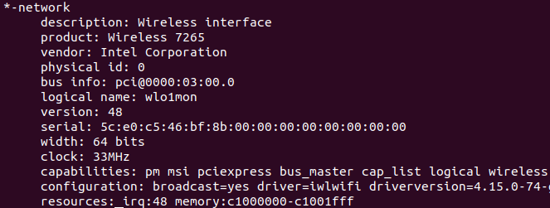
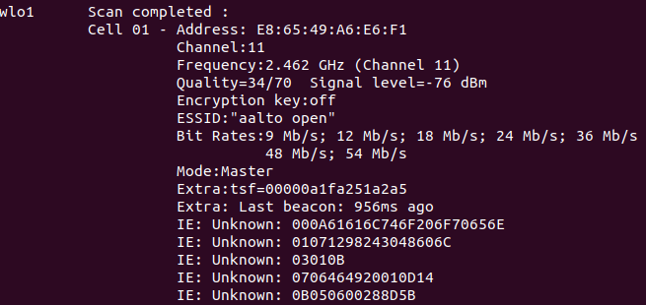
Use command line “sudo lshw -C network” to show the configuration of the wireless interface (Figure 1).
Use command line “sudo iwlist scanning” to scan all APs observed and their information (Figure 2).
Figure 1
Figure 2

Slide 2
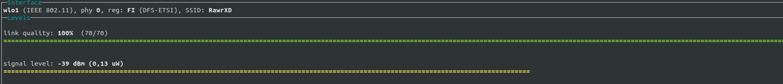
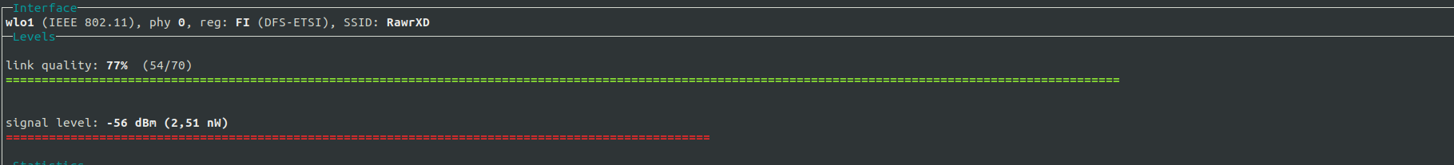
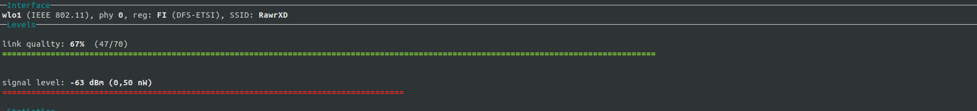
3) First, to measure wireless signal strength, I installed “wavemon” by the command line “sudo apt-get install wavemon”. Here are different results of signal strength based on different distances and obstacles.
Conclusion:
The farther the distance is, the weaker the signal strength is
The denser the obstacle is, the weaker the signal strength is
Figure 3: 0 meter away
Figure 4: 5 meter away
Figure 5: Behind 1 wooden door

Slide 3

4) In order to parse the beacon frame, I have to set my computer to moniter mode by these follow steps:
Become superuser by the command line “sudo bash” and then “su”
Install “aircrack-ng” by the command line “sudo apt install aircrack-ng”
Set my laptop to monitor mode by the command “airmon-ng start wlo1” while “wlo1” is my wireless interface
Open “wireshark” and start capturing packets from wlo1 to parse the beacon frames
Figure 8: AP’s MAC address
Figure 6: Frame control field of the beacon frame
Figure 9: Indicates the beacon frame is transmitted by an AP
Figure 7: Interval of transmitting the beacon frame
Figure 10: AP’s name

Slide 4


5) First connect 2 laptops to one AP and download iperf by the command line “sudo apt-get install iperf”. Then:
Check the private IP address of laptop A by the command line “ifconfig”
Set laptop A to server by the command line “iperf -s”
Set laptop B to client of laptop A by the command line “iperf -c ‘laptop A’s IP address’”
Figure 11: Data transfer shown in client laptop
Figure 12: Data transfer shown in server laptop

Slide 5
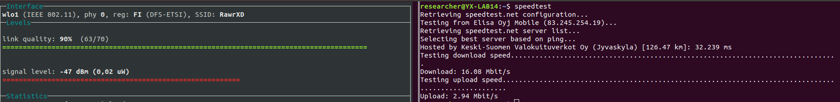
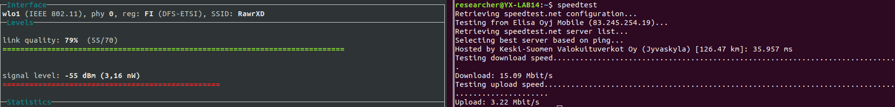
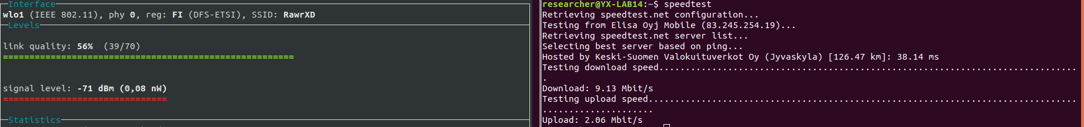
6) I downloaded “speedtest” to measure the data rate by the command line “sudo apt-get install speedtest-cli”
Conclusion:
There is an optimal range (0 meter to 5 meter away) that the data rate stays almost stable. Outside of that range, the data rate will decrease linearly.
Outside the optimal range, the data rate and the signal strength will be weakened by distance and obstacles.
Figure 13: 0 meter away
Figure 14: 5 meters away
Figure 15: 10 meters away

